Slide 1

GPS-Guided RFID Moisture Sensing Robot
William Major
Austin Tran
Sero Nazarian
Project Advisor: Donald Hung

Slide 2
Description of Project
Designed for Industrial buildings
Autonomous GPS-guided robot
Maps roof moisture using RFID-embedded tiles
Transmits data offsite
Mobile application platform

Slide 3
RFID
Windows console designed with C#
  Change settings on the RFID reader
  Send commands to RFID reader to read tags
  Read and process information from RFID reader
Terminal program for server based operation
  Send commands to RFID reader to read tags
  Read and process information from reader

Slide 4
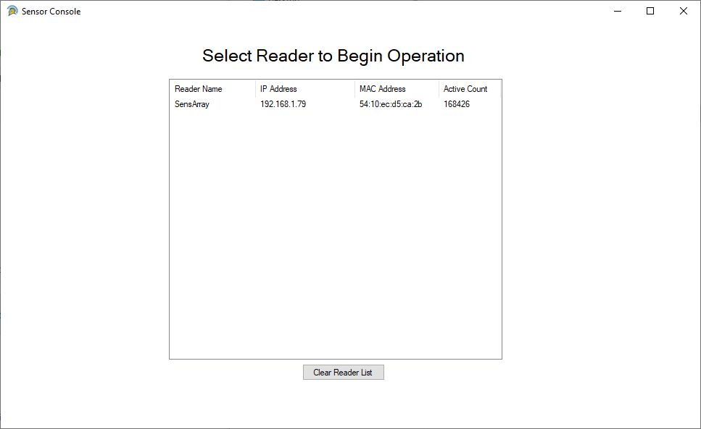
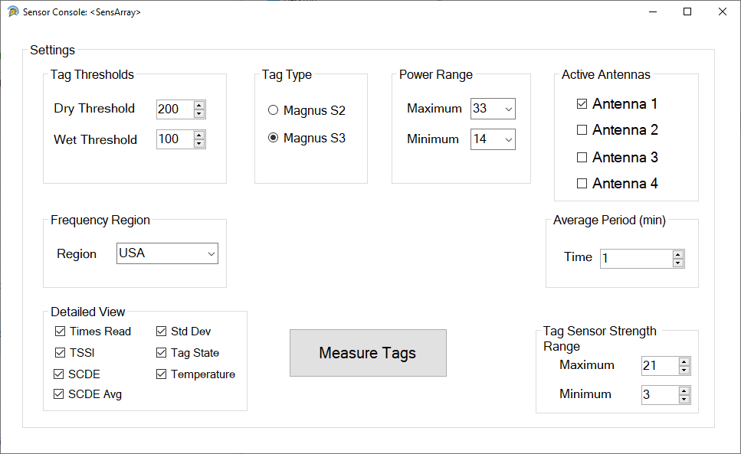
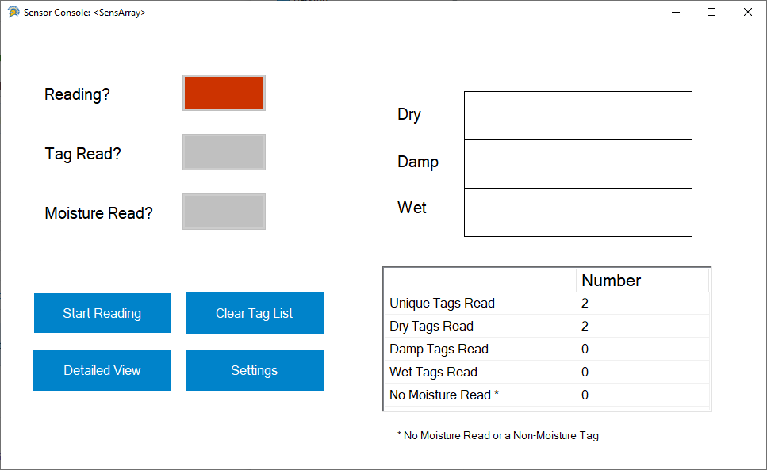
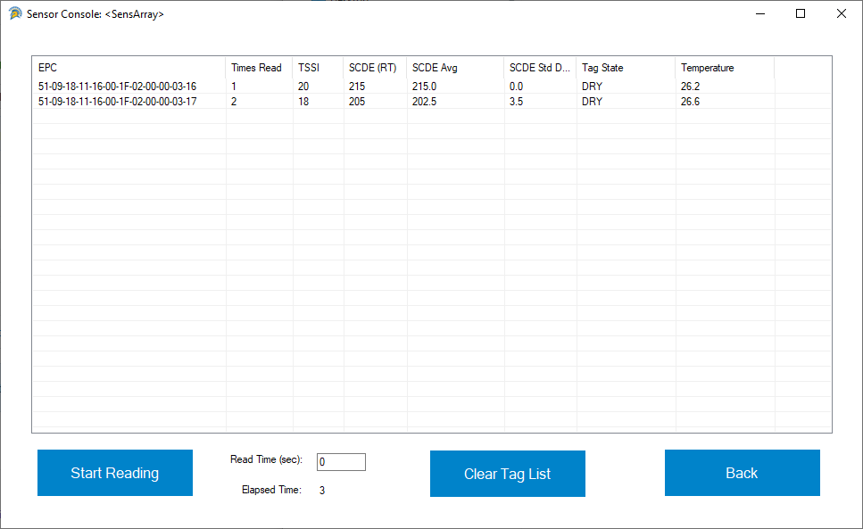

Slide 5
Robot
Geo-Fencing
  Robot is able to follow the parameter of the roof
  Robot creates a geo-fence using onboard GPS
Roof Mapping
  Robot uses geo-fence to stay on the roof and move back and forth mapping tiles on the roof top
  Read and process information from reader

Slide 6
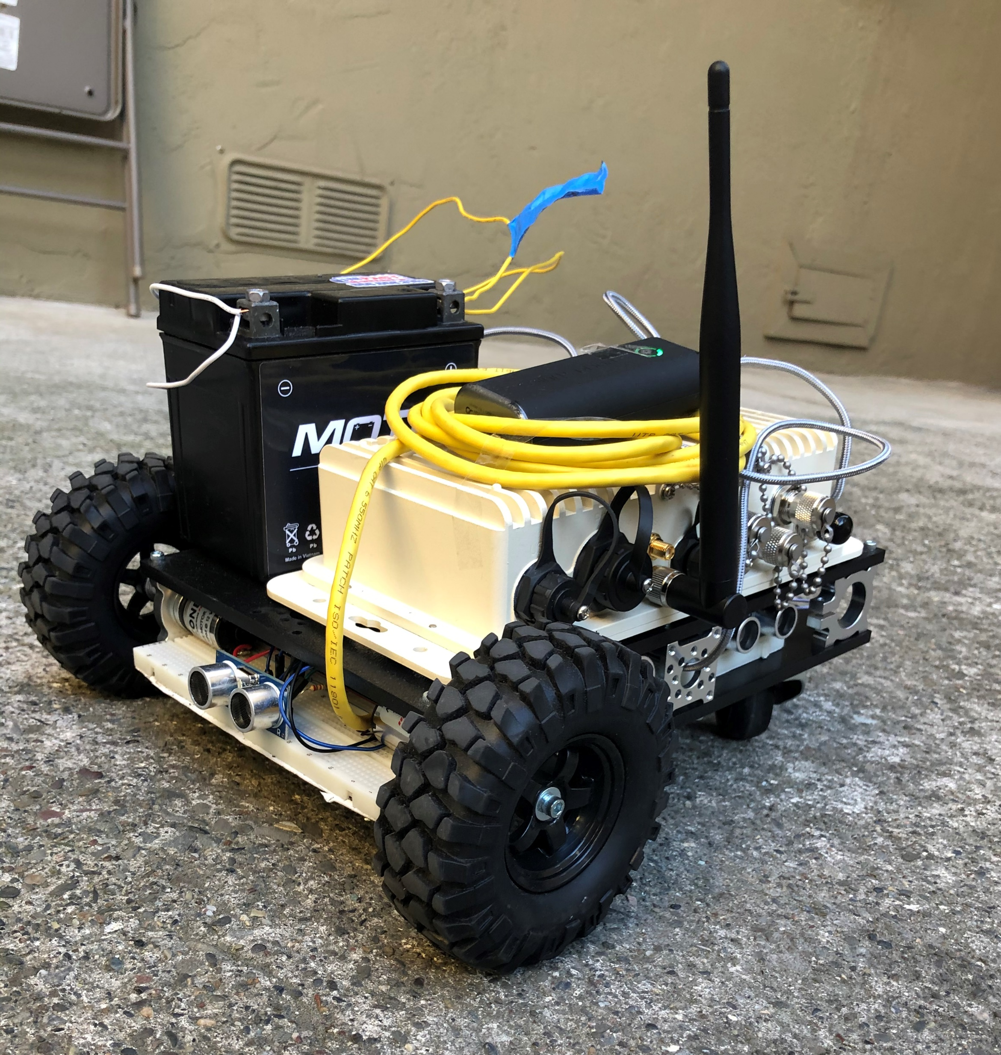

Slide 7
Mobile Application
Simple Design to display all tags read
  Data passed to application by reader through a CSV file
Detailed Information about tag when selected from table

Slide 8
